Slide 1


Semantic segmentation of satellite images
upGrad
NAME : Sai Shankar Gattu
REG NO :12016277
SECTION : K20UP
COURSE NAME : CSE 441 (INDUSTRY INTERNSHIP PROJECT)/ CSE 448 (INDUSTRY CO – OP PROJECT-II )
MENTOR NAME : Ved Prakash Choubey

Slide 2
introduction
upGrad
Satellite images play a crucial role :
Offering valuable insights
In managing natural resources, urban development
In disaster response
Enables informed decision making

Slide 3
ABOUT THE PROJECT
upGrad
Harnessing the power of satellite images using Deep Learning:
Complex patterns can be identified and classified.
Reduces the need for manual Intervention.
Helps in disaster management
Addresses real world challenges and improves quality of life.

Slide 4
Road map
upGrad
DATA COLLECTION – Humans in the loop organization(https://humansintheloop.org), Google Maps
DATA PREPROCESSING STEPS :
Data loading
Image patching
Normalization
Label and One Hot encoding
Model Training
Model Prediction

Slide 5
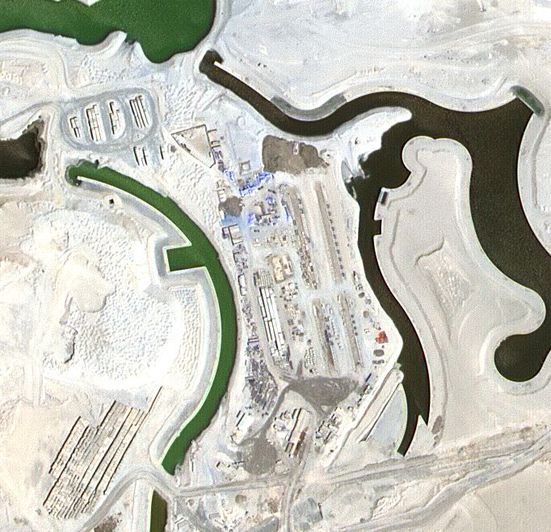
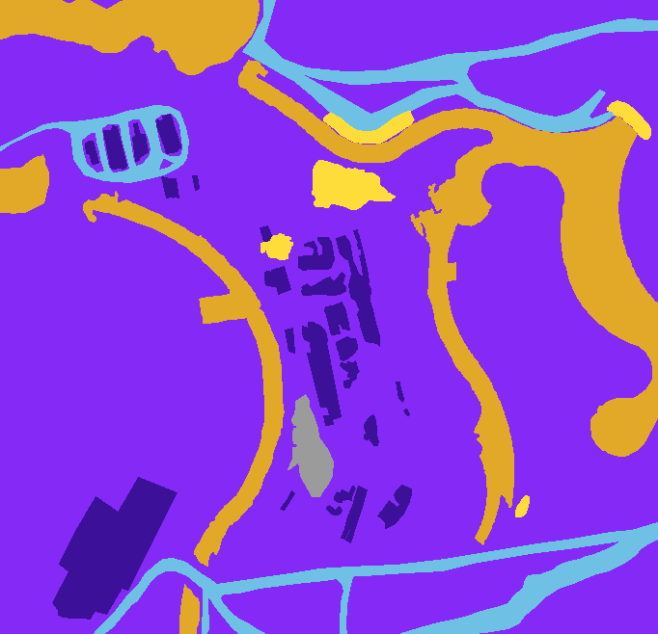
dAta VISUALIZATION
upGrad
Original Image
Masked Image

Slide 6
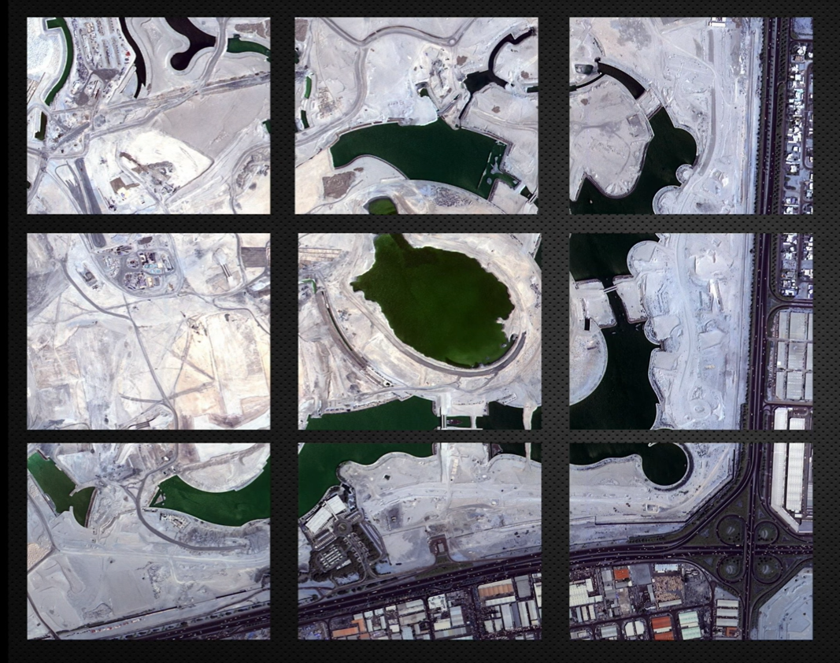
STEPS OF EDA
upGrad
IMAGE PATCHING :
Since deep learning models often work with fixed-size inputs, the large satellite images are divided into smaller patches. This is achieved using the patchify library, which splits the images into patches of a specified size.

Slide 7
dAta analysis
upGrad
NORMALIZATION:
To standardize the pixel values within each patch, Min-Max scaling is applied. This step ensures that the pixel values fall within a specific range, typically between 0 and 1. This scaling is performed separately for both image and mask patches.
LABEL ENCODING:
The masks associated with the satellite images contain semantic labels such as buildings, roads, vegetation, etc. These labels are encoded into numerical values to facilitate model training. Each pixel in the mask is assigned a numeric label corresponding to its semantic class.

Slide 8
Model selection
upGrad
U-Net Model:
Ideal for Semantic Segmentaion
Encoder-Decoder Architecture
Skip Connections
High Resolution Output
Flexibility and Customization

Slide 9
Model selection
upGrad
MobileNetV2 Model:
Lightweight and Efficient
Pre-trained weights
Diverse Applications
Scalability

Slide 10
insights
upGrad
Efficiency of model:
U-Net and MobileNetV2 complement each other in this project by combining U-Net's segmentation capabilities with MobileNetV2's efficient feature extraction.
U-Net focuses on precise segmentation, while MobileNetV2 provides a lightweight yet effective backbone for capturing hierarchical features
The combination allows for accurate segmentation results while maintaining computational efficiency, making it suitable for real-time or edge device deployment scenarios.

Slide 11
Challenges and solutions
upGrad
Uneven data dimensions and its overcoming by performing patching
Choosing Suitable Architectures
Resource Constraints
Interpretation of Results

Slide 12
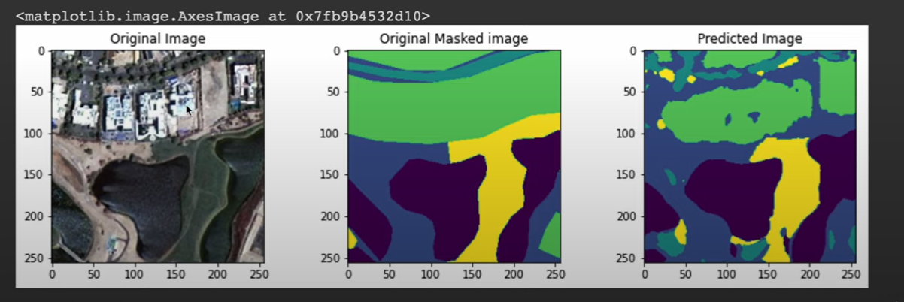
Results
upGrad
Predictions:

Slide 13
conclusion
upGrad
The preprocessing steps played a pivotal role in laying the foundation for the development of a robust semantic segmentation system for satellite images.
This project sets the stage for impactful advancements in remote sensing technology and its applications across diverse domains.
Demonstrated the model's potential impact in various domains, including medical imaging, satellite imagery analysis, environmental monitoring, Urban Planning, Disaster management

Slide 14
thank you
upGrad

